Slide 1
TILT: Transparency in Learning & Teaching
2022 UAA Assessment Retreat
Britteny M. Howell & Stasia Straley
Notes:
Britteny

Slide 2
Concepts of TILT
Transparency in Learning and Teaching (TILT) aims to advance equitable teaching & learning practices that reduce systemic inequities in higher ed through:
Promoting students’ conscious understanding of how they learn, and
Enabling faculty to gather, share, and benefit from current data about students’ learning to coordinate their efforts across disciplines and institutions
Notes:
Britteny

Slide 3
TILT in Higher Education
Transparent teaching methods help students understand how and why they are learning course content in particular ways. Faculty participants are encouraged to employ one easy, transparent change and try to determine the impact of this small change on student learning.
Notes:
Britteny

Slide 4
Some Transparent Methods
Invite students to participate in class planning and agenda construction
Gauge students’ understanding during class via peer work on questions that require them to apply concepts you’ve taught
Explicitly connect “how people learn” data with course activities
Engage students in applying the grading criteria that you’ll use on their work
Debrief graded tests and assignments in class
Discuss assignments’ learning goals and design rationale
Notes:
Britteny

Slide 5
Transparent Method 6: TILTing Assignments
6) Discuss assignments’ learning goals and design rationale
Chart out the skills students will practice in each assignment
Begin each assignment by defining the learning benefits to students
skills practiced
content knowledge gained
the tasks to be completed
the criteria for success
Notes:
Britteny

Slide 6
TILTing Your Assignments
Purpose: (why are we doing this?)
What are the objectives for the assignment?
What skills will students practice doing this work and knowledge will they gain from doing the work? What will be involved and how will those be important in students’ lives and work beyond the assignment?
Task: (what do we need to do?)
What do students need to do to complete the assignment?
How should they complete the task/steps?
Clear instructions allow students to spend less time figuring out what to do and more time on the actual task.
Criteria: (how will we know if we’ve been successful?)
What are the characteristics of a successful finished product?
How will the assignment be assessed?
Include a checklist of expectations or a rubric.
Include an example of a successful (and possibly unsuccessful) product.

Slide 7
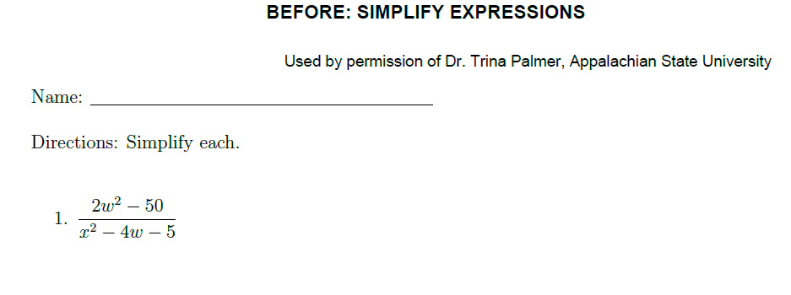
Example TILTed Assignment: Before

Slide 8
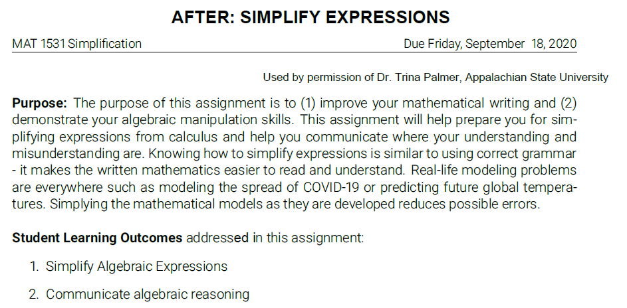
Example TILTed Assignment: After

Slide 9
Example TILTed Assignment: After 2

Slide 10
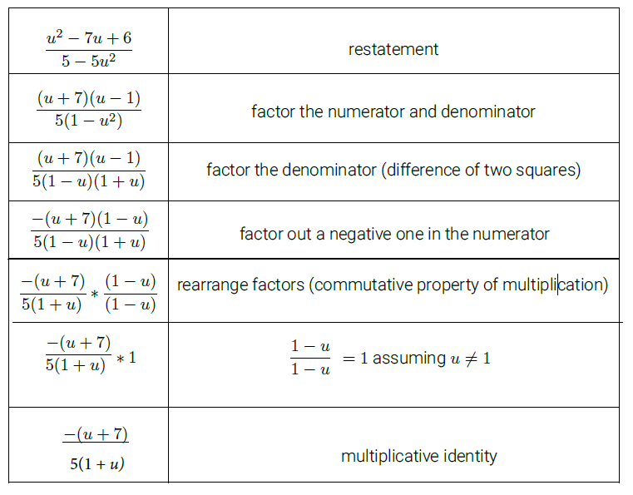
Example TILTed Assignment: After 3

Slide 11
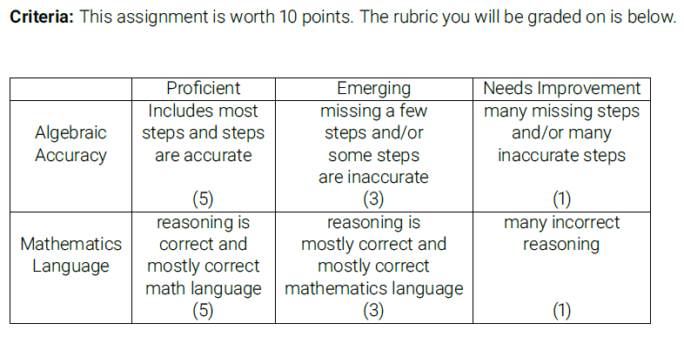
Example TILTed Assignment: After 4

Slide 12
It Works
Students who received transparent instruction demonstrate elevated confidence, belonging, and metacognitive awareness of skill development.
Confidence and belonging are success predictors that correlate with increased persistence and higher grades.
Increases in student persistence for students who receive transparent instruction last at least two years. Benefits are greater for underserved (first generation, low income, underrepresented) students.
TILT assists in the metacognition process.
Providing examples allows students to begin at the same starting line, with equitable access to information about what good work looks like.

Slide 13
Additional TILT Resources
TILT course
TILT Website
TILT Examples and Resources
TILT FAQ
TILT Template
Transparent Assignment Template
Checklist one and Checklist two
Transparent Design in Higher Education Teaching and Leadership : A Guide to Implementing the Transparency Framework Institution-Wide to Improve Learning and Retention by Mary-Ann Winkelmes, Allison Boye, Suzanne Tapp, Peter Felten, and Ashley Finley

Slide 14
What questions do you have?
Britteny M. Howell bmhowell2@alaska.edu
Stasia Straley scstraley@alaska.edu

