Slide 1
UAA’s Core Competencies: How We Got Here
Goal: Identify institution-wide student learning core competencies that would be promoted in all phases of the university: curricular, co-curricular, and extra-curricular.

Slide 2
Rationale
Student learning takes place across the entire campus and includes curricular, co-curricular, and extra-curricular learning experiences.
The adoption of an institution-wide core competency framework was needed to create a dialogue in which these differing spheres of student learning could be productively brought together.
Creates a more coherent and aligned educational experience for students (Jankowski and Marshall 2017)

Slide 3
Process: Phase I
AY20: Year long deliberative process with stakeholders identifying the key skills and knowledge base essential for academic and post-graduate success.
Open forums and targeted visits to organized stakeholder groups.
An initial list of 31 core competencies was developed. Further deliberation with stakeholders brought this to 7 and finally to 4.

Slide 4
Methodology
Delphi Method: Uses the group expertise to prepare a questionnaire in a focus area of interest, feedback is solicited from the designated experts, revisions are made, and feedback is solicited again to confirm consensus of the revised questionnaire (Giannarou & Zervas, 2014).
Listening….

Slide 5
Sources for the initial Core Competency List:
UAA General Education Student Learning Outcomes
AAC&U Essential Learning Outcomes
Outcomes from AAC&U Employer Survey
Themes from Stakeholder Conversations

Slide 6
Stakeholder Groups
Student Government
Students in Courses
Alumni Association
Staff Council
Faculty Senate
Chancellor’s Cabinet
University Service Area Directors
Core Competency Working Group
University Assessment Committee
University Accreditation Committee
Employers (through Year One NWCCU Fellowship project)

Slide 7
The Core Competencies
Effective Communication: The knowledge and skills necessary to engage in effective communication in diverse contexts and formats.
Creative and Critical Thinking: The knowledge and skills necessary for critical exploration of issues, artifacts, and events in order to creatively design, evaluate, and implement a strategy to answer complex questions or achieve a desired goal.
Intercultural Fluency: The knowledge and skills necessary to promote effective and appropriate interaction in a variety of cultural contexts, particularly in terms of the diverse populations of Alaska.
Personal, Professional, and Community Responsibility: The knowledge and skills necessary to promote flourishing, professional excellence, and community engagement.

Slide 8
Process: Phase II Implementation
AY21: Personal Professional and Community Responsibility
AY22: Effective Communication
AY23: Intercultural Fluency
AY24: Creative and Critical Thinking

Slide 9
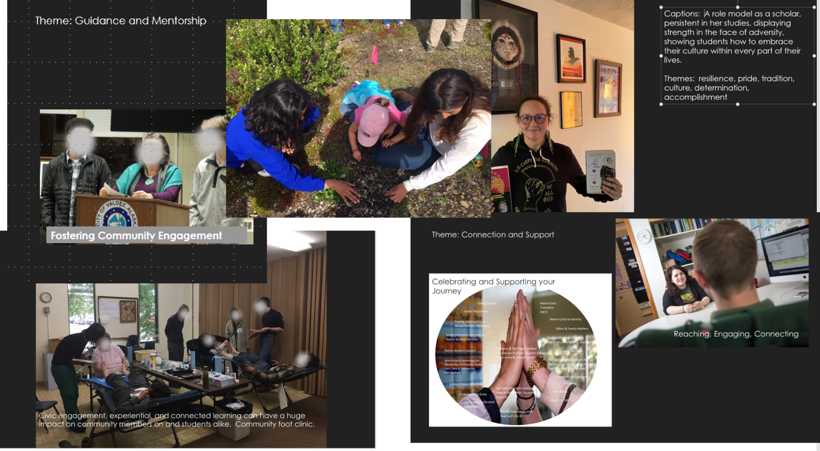
Photovoice
Fall 2020

Slide 10
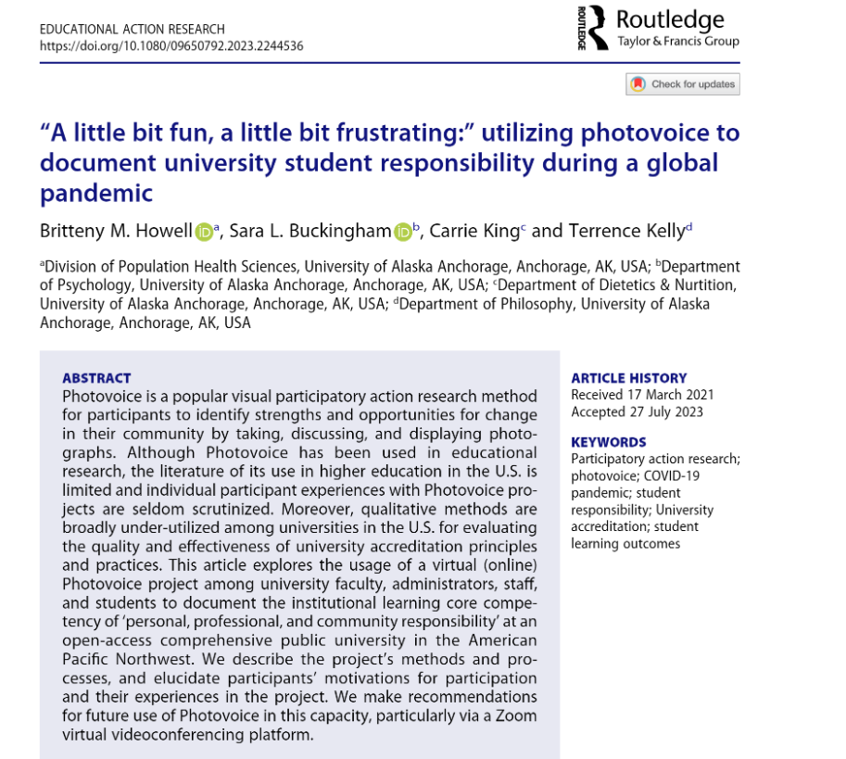
Article

