Slide 1
Institutional Accreditation - Year of Self Reflection -
AY2025 Accreditation Kickoff: The Year of Self Reflection: Where We Are, and Where We Want to Be
UA is an AA/EO employer and educational institution and prohibits illegal discrimination against any individual: www.alaska.edu/nondiscrimination

Slide 2
Evidence of the Core Competencies across the institution
A quick review of the tools

Slide 3
The Core Competencies
Effective Communication: The knowledge and skills necessary to engage in effective communication in diverse contexts and formats.
Creative and Critical Thinking: The knowledge and skills necessary for critical exploration of issues, artifacts, and events in order to creatively design, evaluate, and implement a strategy to answer complex questions or achieve a desired goal.
Intercultural Fluency: The knowledge and skills necessary to promote effective and appropriate interaction in a variety of cultural contexts, particularly in terms of the diverse populations of Alaska.
Personal, Professional, and Community Responsibility: The knowledge and skills necessary to promote flourishing, professional excellence, and community engagement.

Slide 4
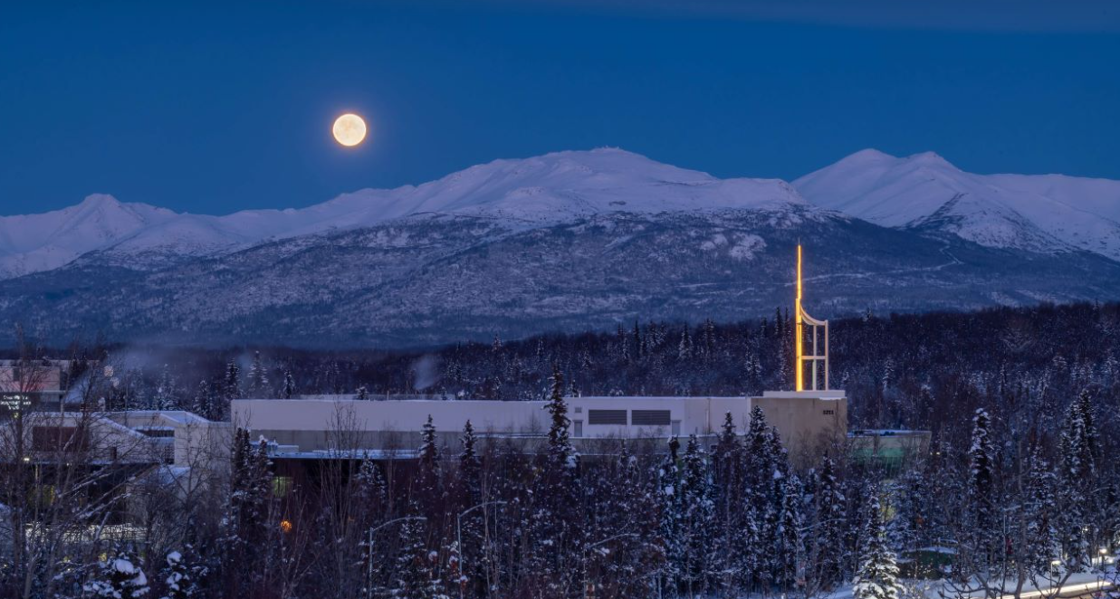
Summer 2024 Non-Academic Landscape Survey
UA is an affirmative action/equal opportunity employer, educational institution and provider and prohibits illegal discrimination against any individual: www.alaska.edu/nondiscrimination.
Notes:
To replace the logo with your unit logo, hold down the CONTROL key (or right click), then click on the logo. In the menu that appears, click “Change Picture” choose From file… and then navigate to your logo file on your computer.
Use the Green and Gold with reverse type version of your logo, the name should look like this - “YOURDEPTNAME-GG-Rvrs.png”. To change the background photo go to the Design Tab, select Format background, for Fill select Picture, then click the insert button and navigate to the photo you want to use on your computer. More photos can be found on the UAA Photo Bank website - https://uaaphotobank.smugmug.com.

Slide 5
What is the Landscape Survey
A process to better understand how areas are intentionally creating student-focused opportunities around the Core Competencies
To clarify what is currently happening, and what is being planned
Focused on Non-Academic programs across all campuses
Advising
ANSEP
Athletics
CAFE/Faculty Success
Campus Services
Career Services
Carolyn Floyd Library
CCEL
Consortium Library
Dean of Students
Disability Support Services
Educational Technology
Employee Experience
Facilities and Campus Services
Financial Aid
First Year Experience
Graduate School
Honors College
Information Technology Services
IT
Kodiak Business Office
Kodiak Student Services
Learning Resource Center
Library
Military and Veteran Student Services
Multicultural Student Services
Native Student Services
Office of Education Abroad
Okeson Library
Registrar's Office
Residence Life
Student Engagement and Inclusion
Student Housing
Student Life and Leadership
Student Services
UAA Advising
UAA Learning Commons
UAA Middle College
University Police
Whitney Museum

Slide 6
What is the Landscape Survey 2
Are you actively working to develop core competencies in students? (Yes or No)
-Which Core Competency(ies) are you planning on helping students develop?
(Then for the selected competency(ies)
- What activity(ies) are you planning on developing to help students develop…?
- How will students know the activity is designed to help them develop
- In the course of your regular operations, where or when will students encounter the activity(ies) mentioned?
- Where/When is the activity (ies) available
- How often will students encounter the activity(ies)?
- When do you plan on having these activities ready for students?
- Does every student have the same opportunity to participate in the activity(ies) listed above?
If “no” can you please explain why
-Which Core Competncy (ies) are you currently helping students develop?
(Then for the selected competency(ies)
- What activity (ies) are you using to help students develop…?
- How does it help students develop …?
- How does the student know it is helping them develop…?
- Where or When are these activities available?
- How often are they available?
- Does every student have the same opportunity to participate?
if “no” then can you please explain why
Yes
No

Slide 7
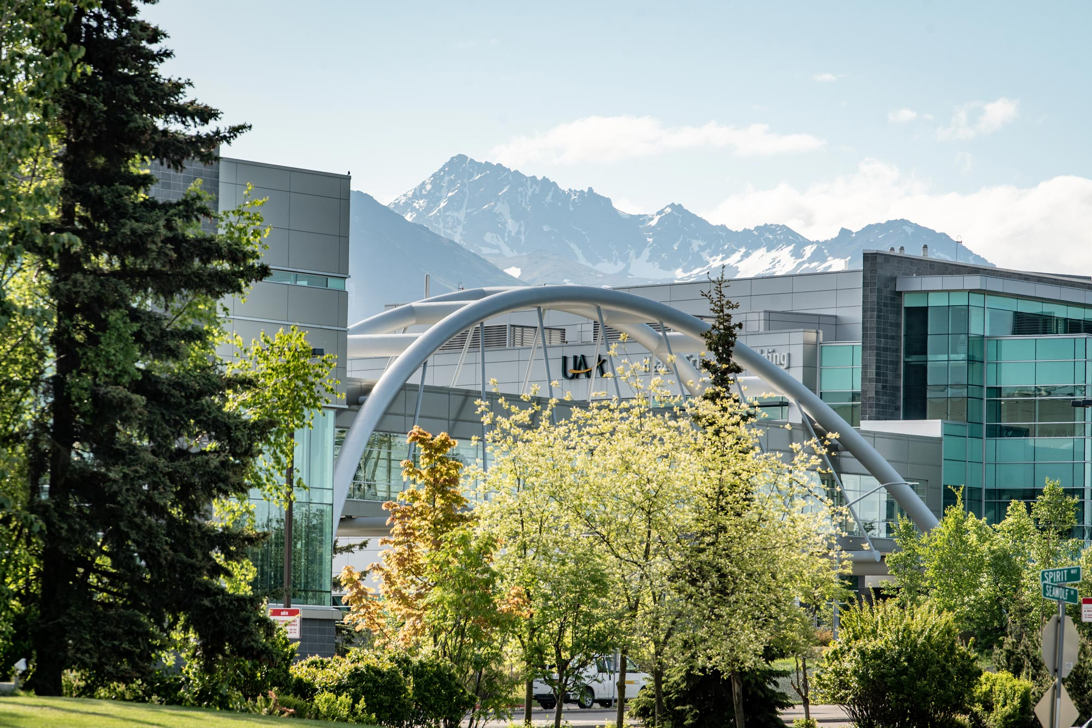
Discussion and next steps

Slide 8
Keynote:
Meaningful and sustainable assessment: What does UAA student learning and success evidence suggest and how can you use it in deep and meaningful ways?

Slide 9
Break – Starting again at 10:30

Slide 10
Dual Mission Visioning

Slide 11
Dual Mission – ACE Definition
Dual mission institutions proudly offer an intentional blend of liberal arts programs and hands-on career skills training under one roof, generally through a mix of undergraduate (and/or graduate) offerings ranging from bachelor’s and associate degrees, to specialized certificates.
These institutions may be either public or private, but are generally open access and significantly more affordable than other colleges and universities. Dual mission institutions typically offer streamlined pathways for students, nimble operational structures, and close-knit community and workforce partnerships. Because of their “hybrid” nature, they may also not “fit” well in traditional Carnegie or other post-secondary classification systems.

Slide 12
Visioning
Is UAA a Dual Mission University?
It certainly seems we are.
How does embracing this identity change how you think of UAA and your work?
Are there aspects of your work that could/should change based on this definition?

Slide 13
Dual Mission of the Future
Imagine it’s 2031, and UAA has just been named by US News & World Report as the #1 ranked Dual Mission University in its annual ranking!
Why are we ranked #1 in this category?
What did we change about what we do, and how we do it, that set us up to become the “best” Dual Mission university in the US?

Slide 14
Reflection on the Dual Mission visioning conversation

Slide 15
Next steps in the accreditation process and how you can help

Slide 16
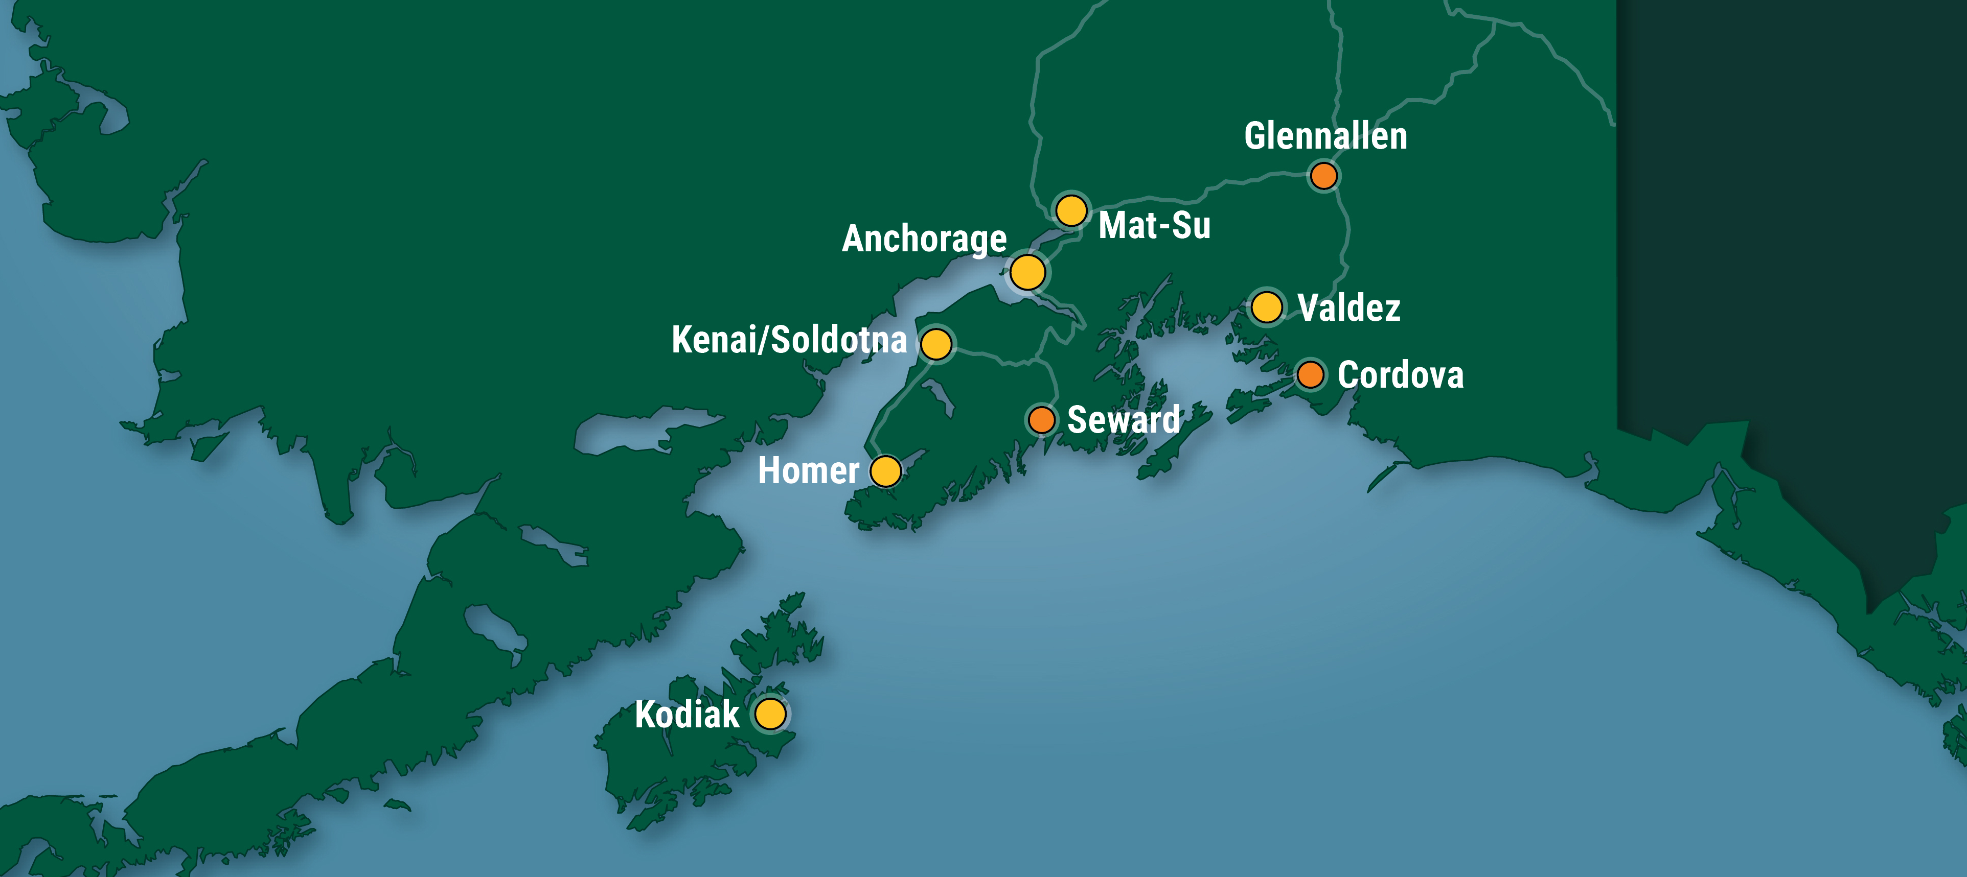
Thank You!

